Slide 1
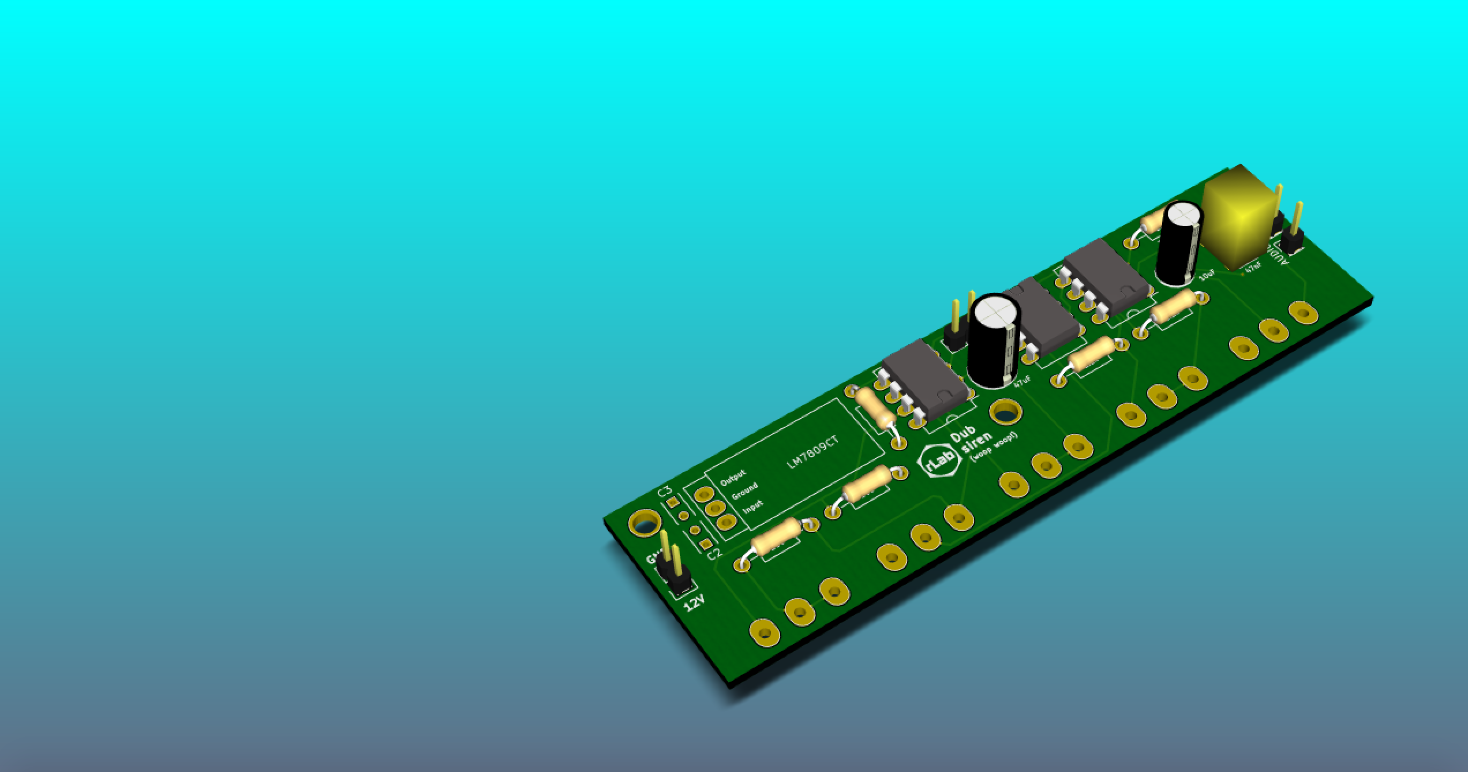
The basic anatomy of a 2-layer PCB

Slide 2
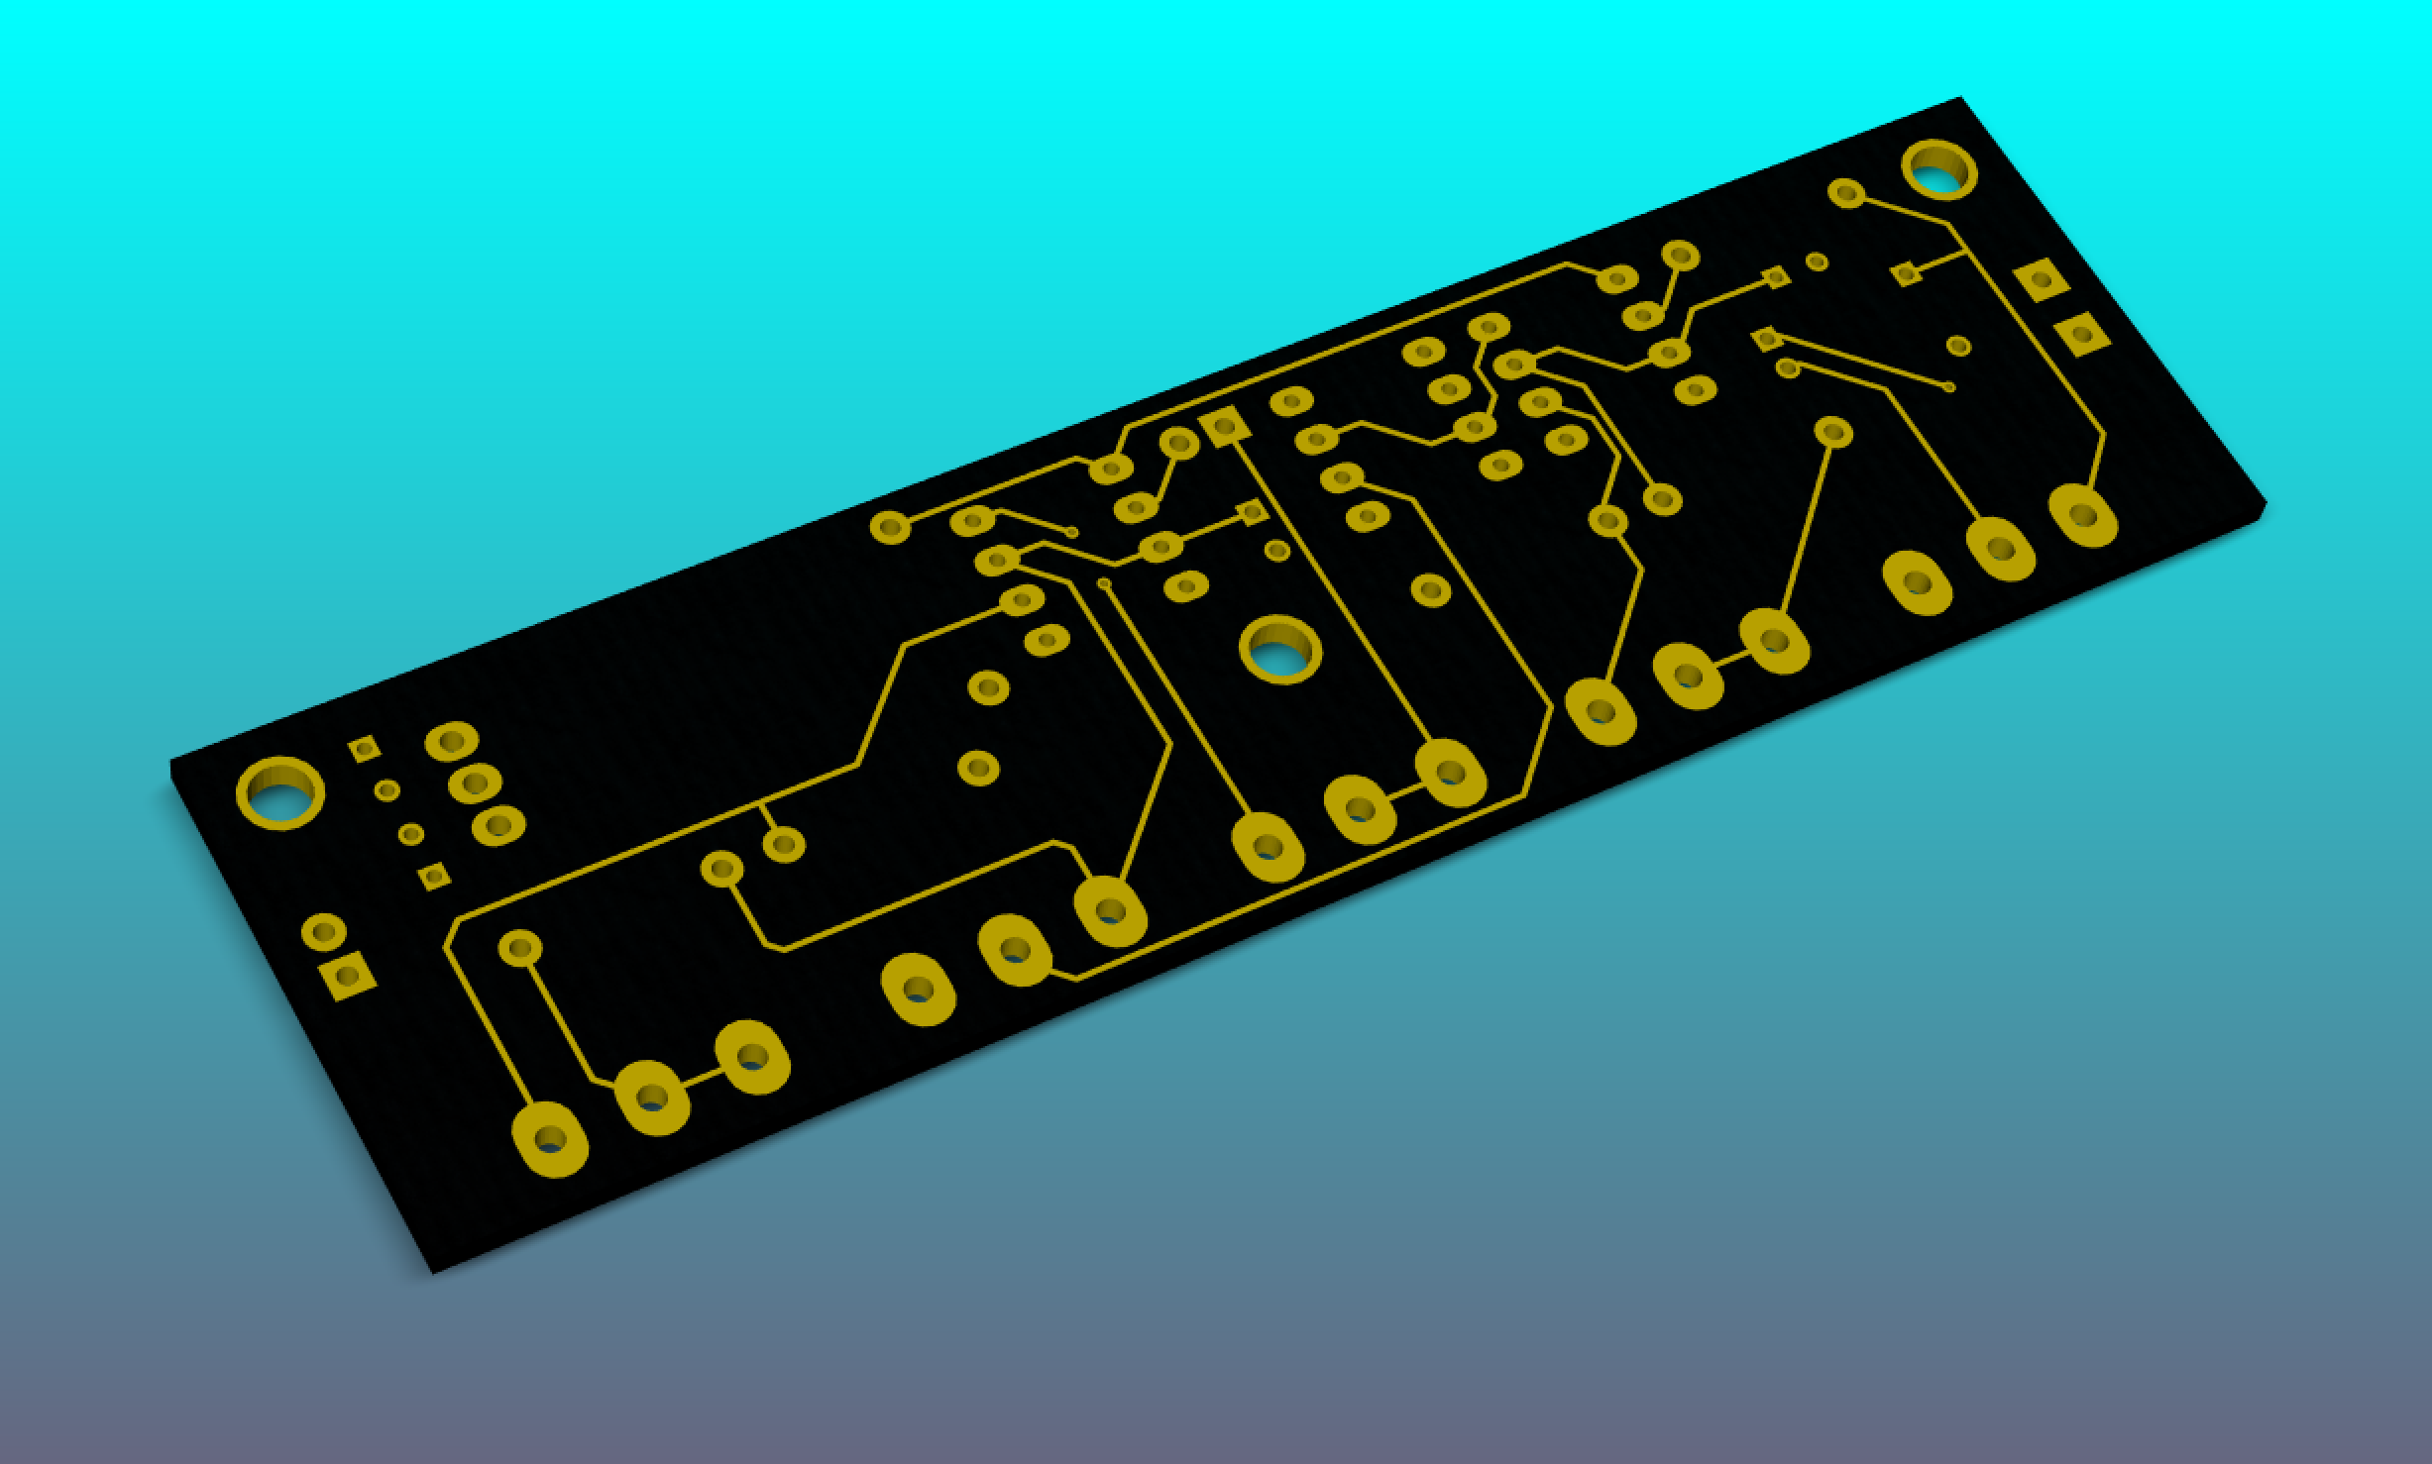
Boards start life as a piece of ‘substrate’ coated on each side with a layer of copper
The copper is etched away to leave just the copper required for your circuit
‘Vias’ (small dressed holes) are used to make connections between the two sides of the board
Dressed holes are surrounded by ‘annular rings’ of copper, again to improve electrical contact
Holes are drilled through for through-hole components. These can be plated inside to improve electrical contact. These are called ‘dressed holes’

Slide 3
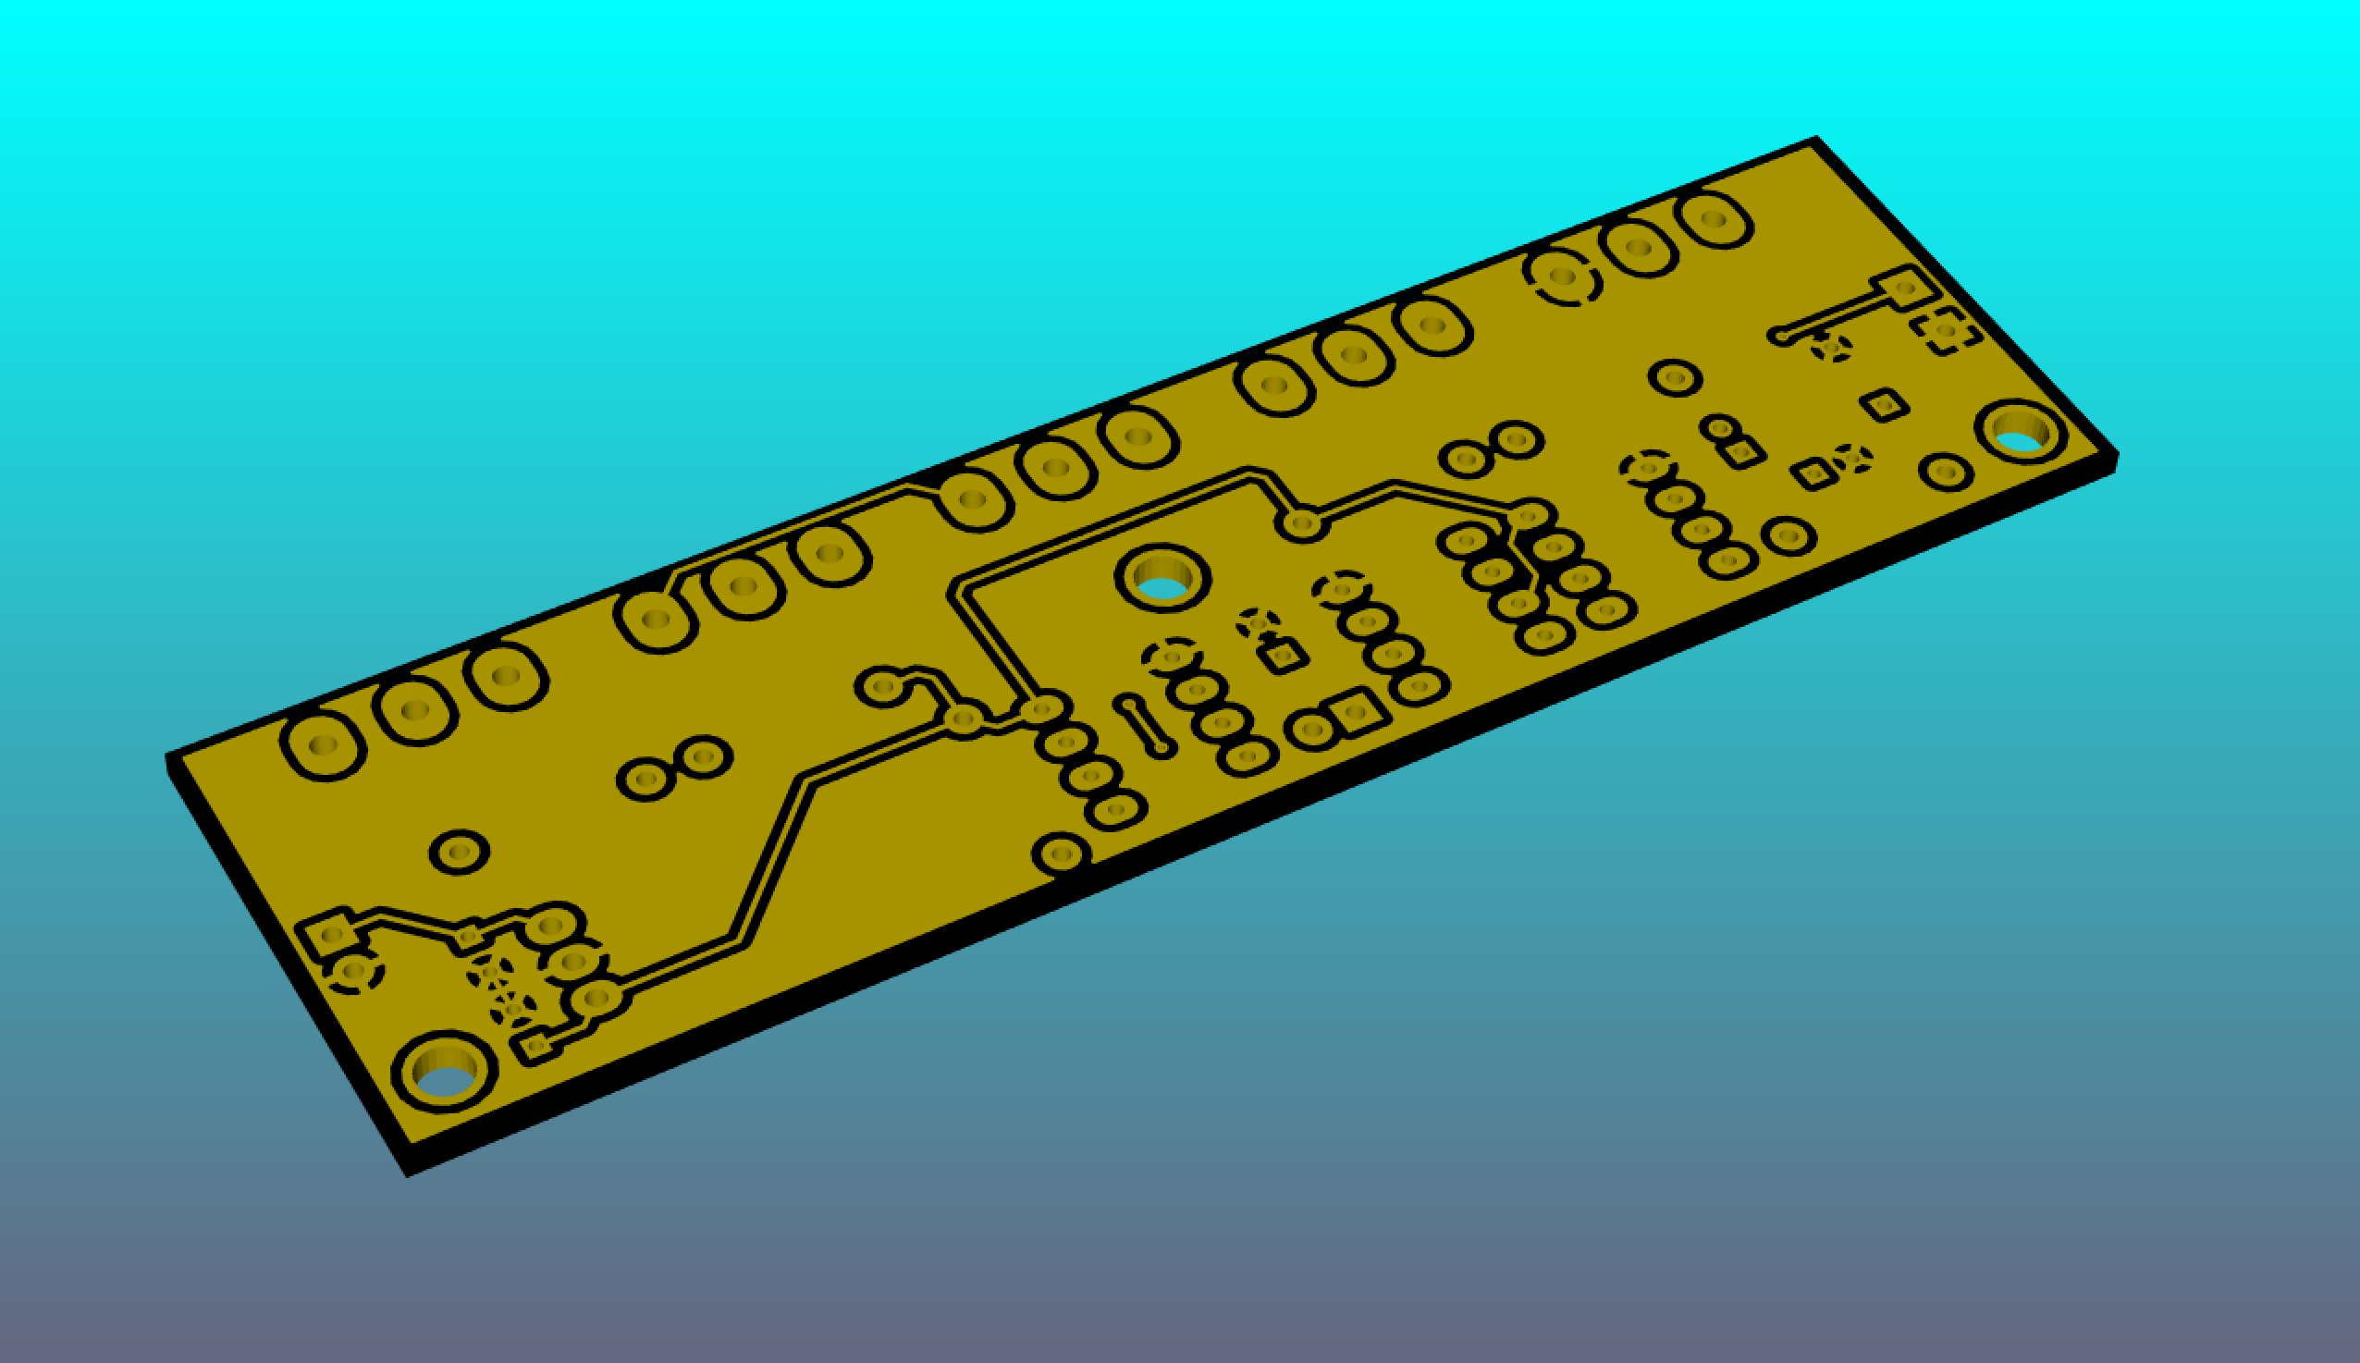
On this side of the board, a large zone of copper has been left to act as a ‘ground plane’. This provides for a common ground across the circuit.
Such zones can also be useful for heat dissipation
Zones can be so good at dissipating heat that they can make it hard to solder. Here the annular ring is only partially connected to the ground plane in order to provide ‘thermal relief’

Slide 4
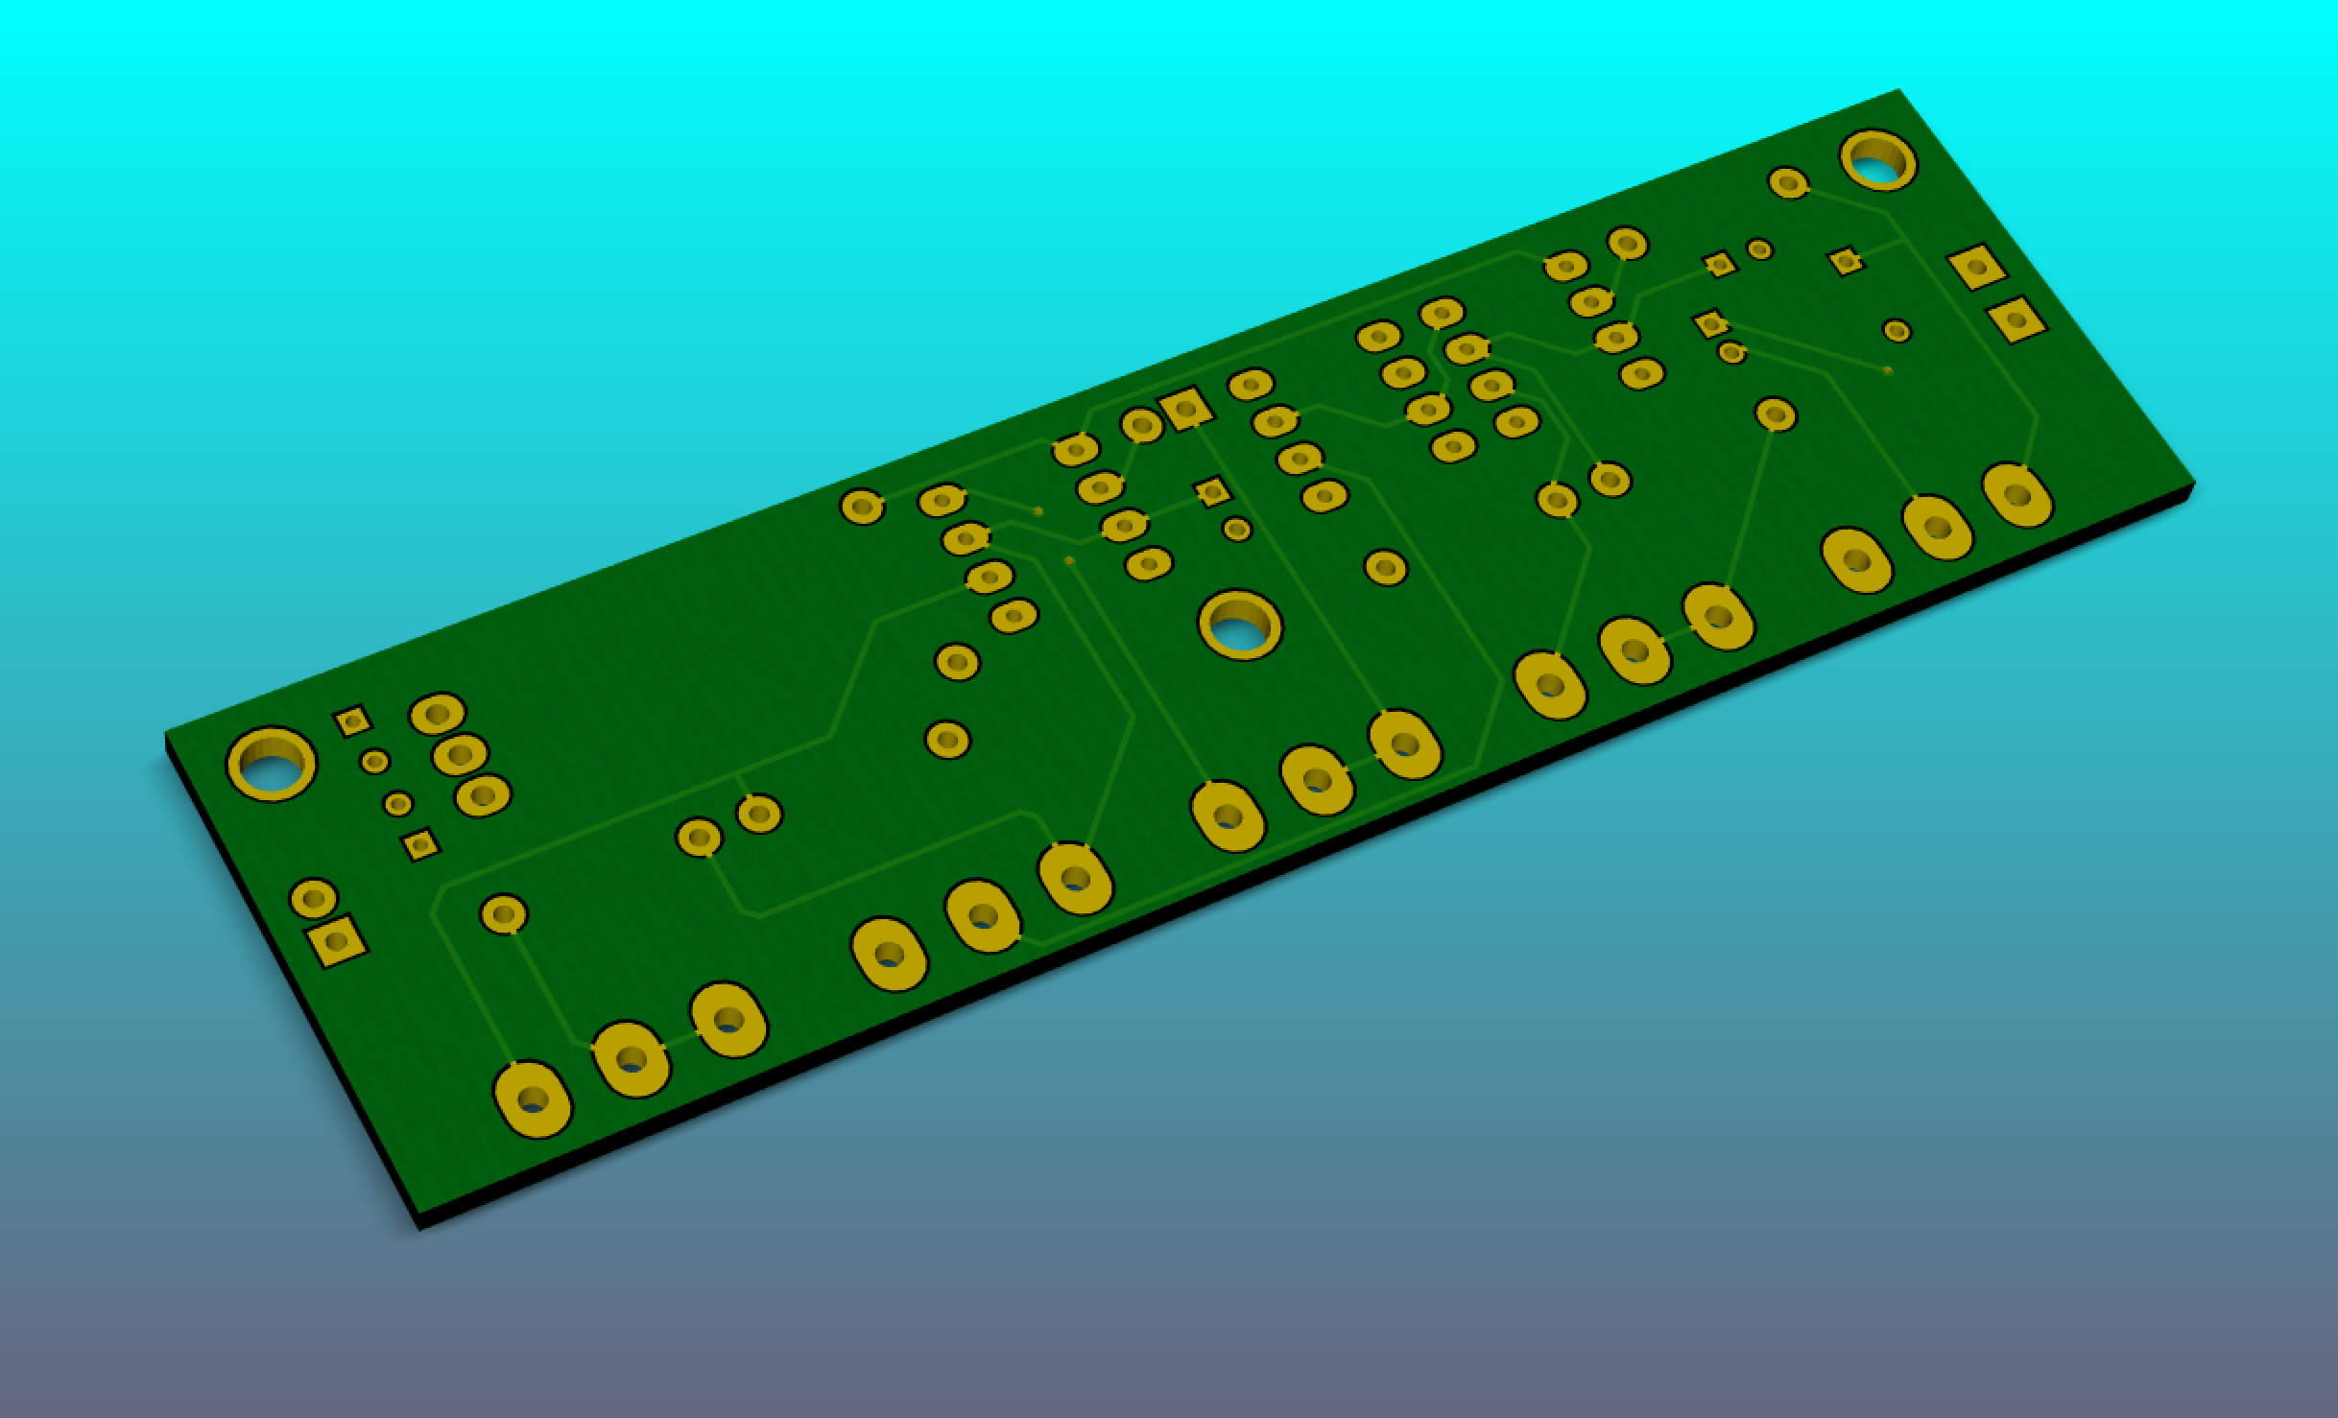
‘Solder mask’ is added to protect the copper. It repels solder and can help prevent bridging when pads are close together.
During manufacture, any exposed copper will be coated with a layer of solder (or gold!) to aid conductivity. HASL – Hot Air Solder Levelling – is a cheap and popular technique.

Slide 5
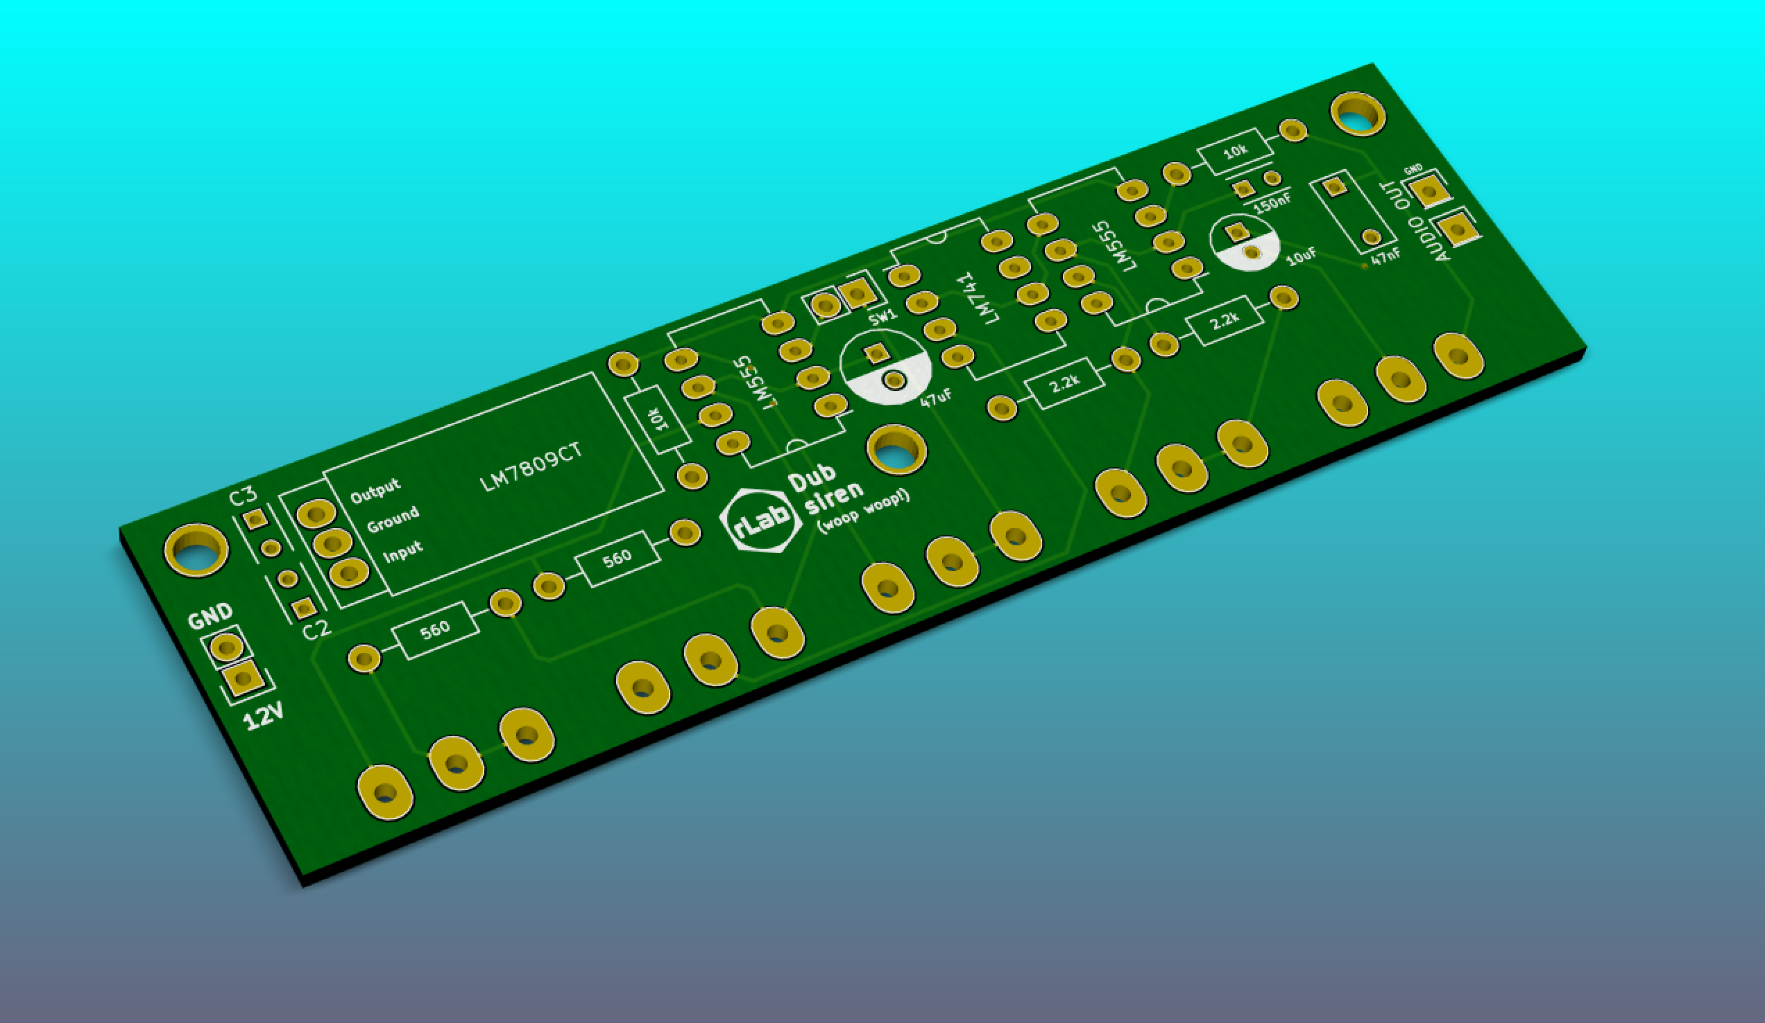
Text and other component markers can be added with a ‘silk screen’ layer to aid assembly and debugging of the board
Designs can also be added to improve the appearance of the PCB

